Slide 1
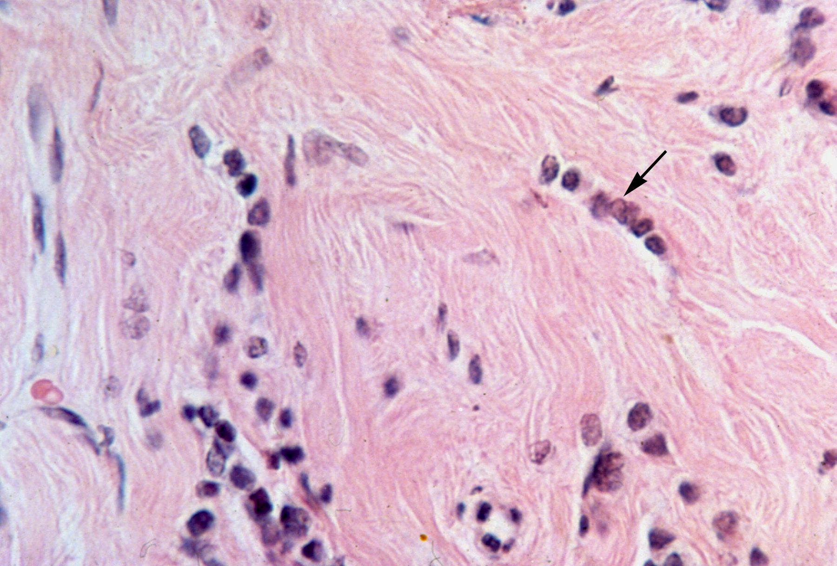
Overview: Basic Science and Biology of ILC and Clinical Consideration of Primary/Early Stage ILC
#ILCSYMPOSIUM
Session 1
Session Moderator: Steffi Oesterreich, PhD
Lori Petitti, Patient Advocate
Claire Turner, Patient Advocate
Patrick Derksen, PhD
Cathrin Brisken, MD, PhD
Jacqueline Jeruss, MD
Rachel Jankowitz, MD
September 28th, 2023
Do Not Copy. Author Permission Required.

Slide 2
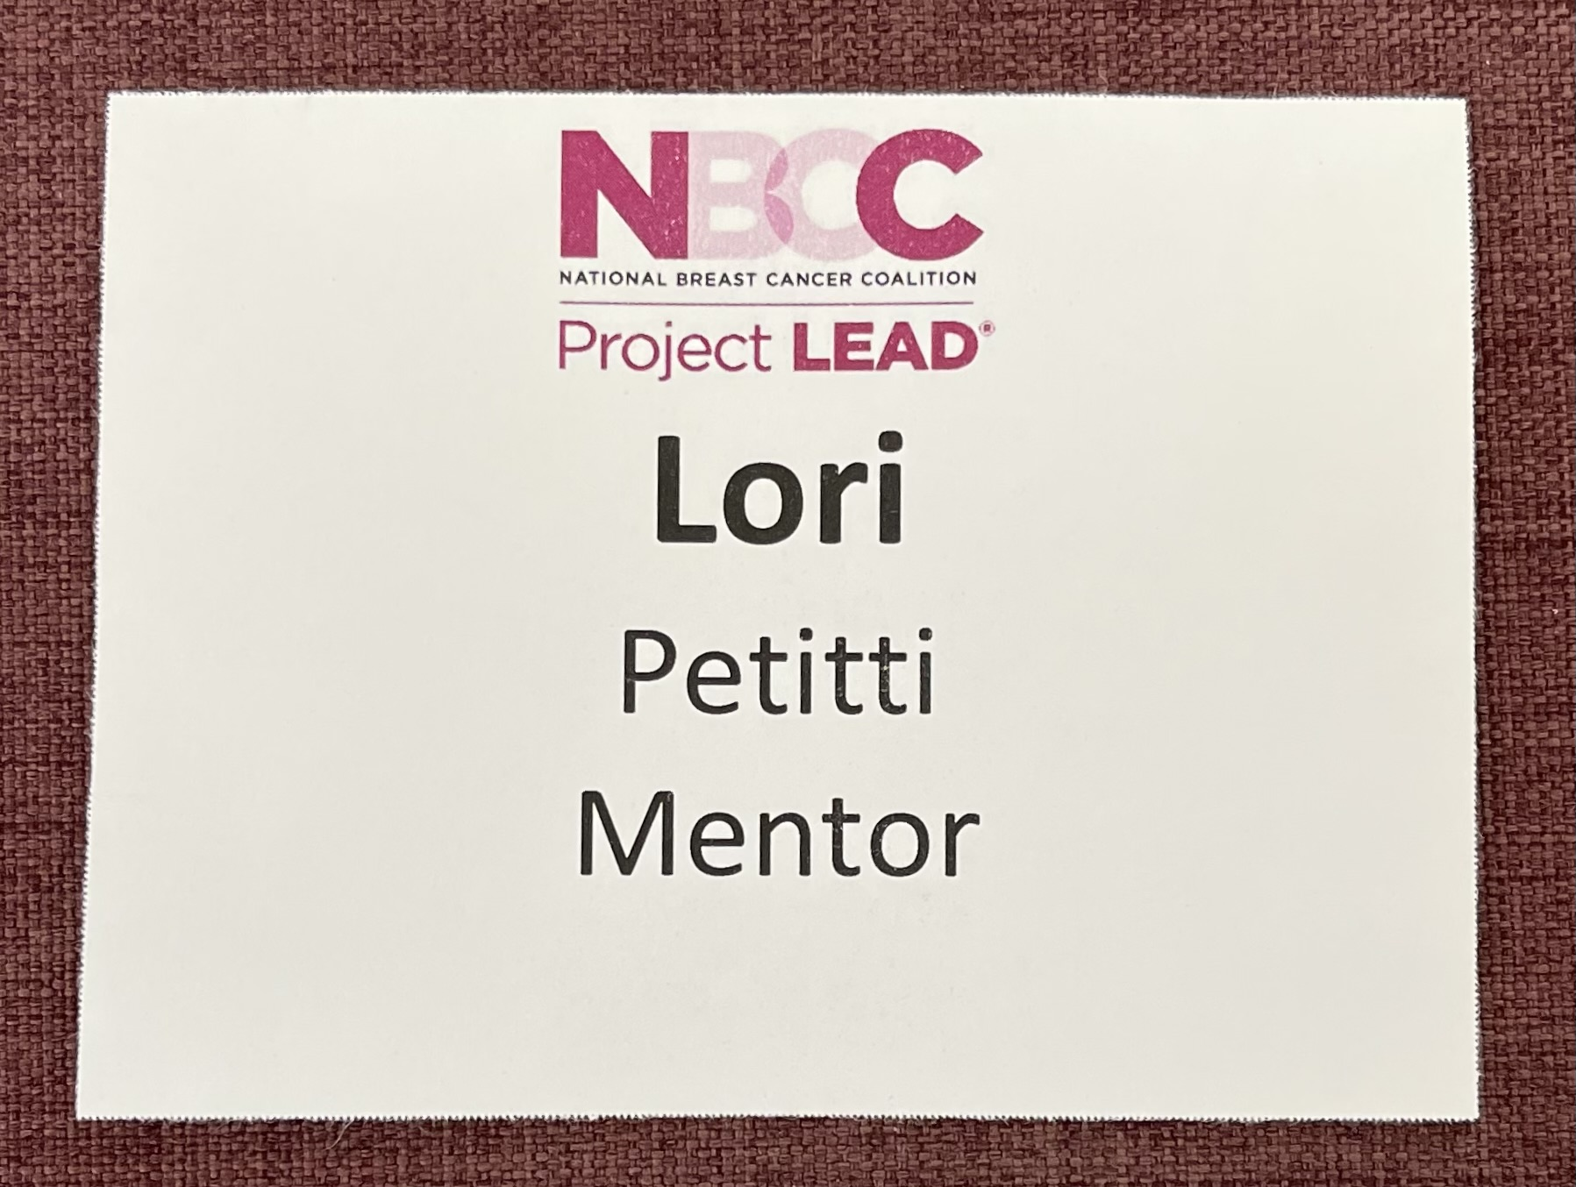
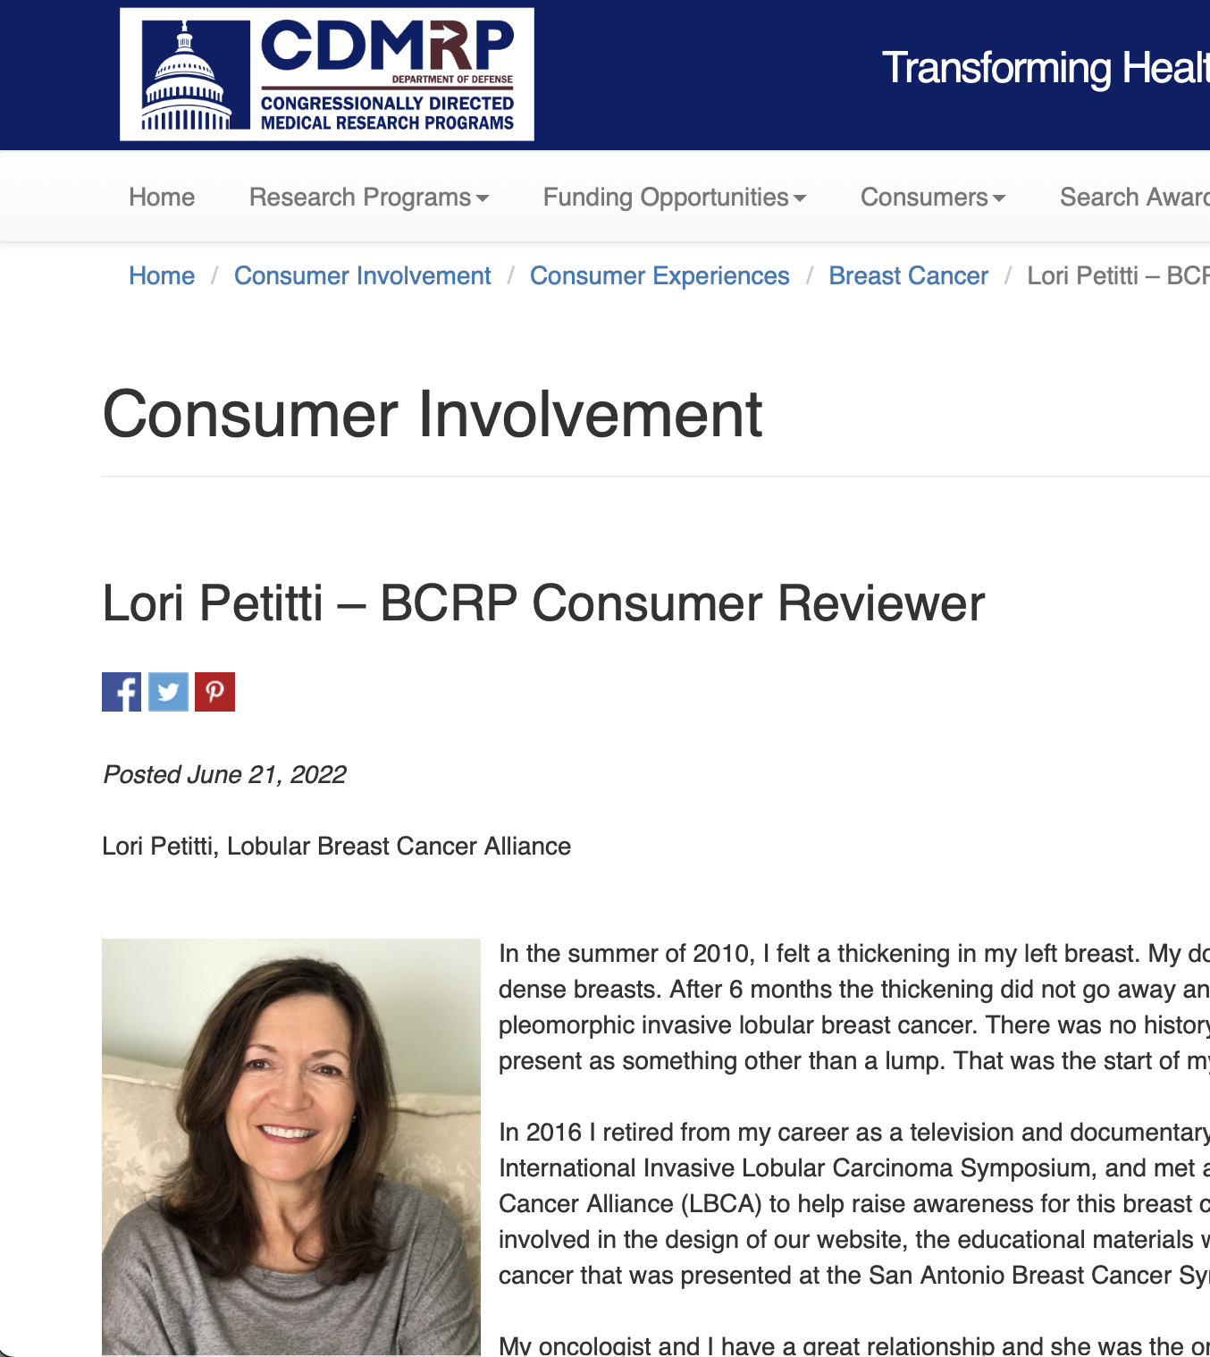
Lori Petitti, Patient Advocate
13 year Stage II pleomorphic lobular breast cancer survivor
Founding Member LBCA
Board member, Breast Cancer Care & Research Fund, Los Angeles
SHARE and ABCD peer-to-peer support
DoD Breast Cancer Research Program Consumer Reviewer
Actively engaged in various projects involving basic, translational
and clinically focused research aims

Slide 3
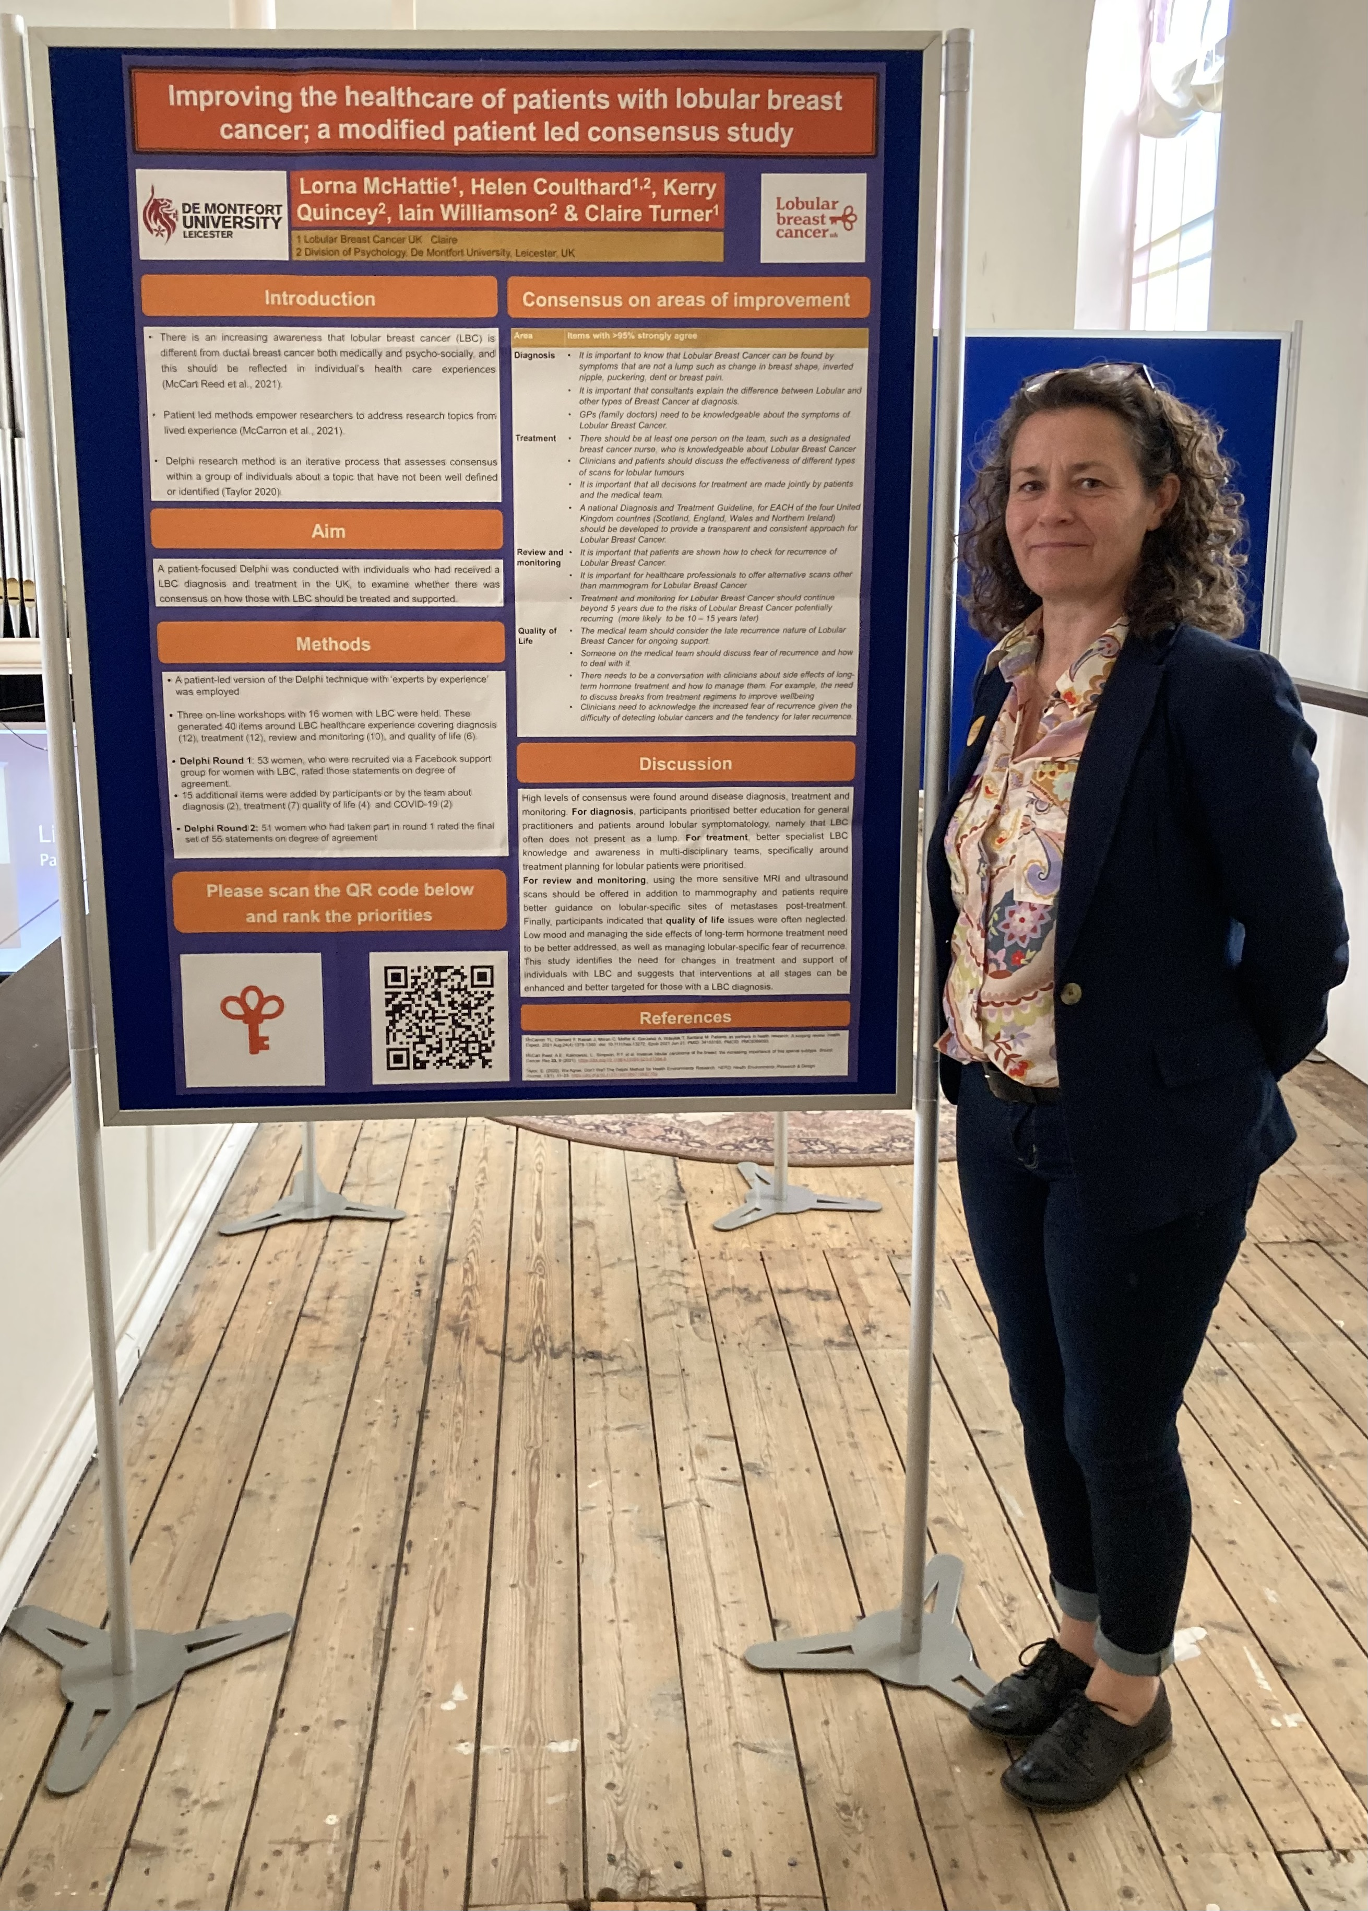
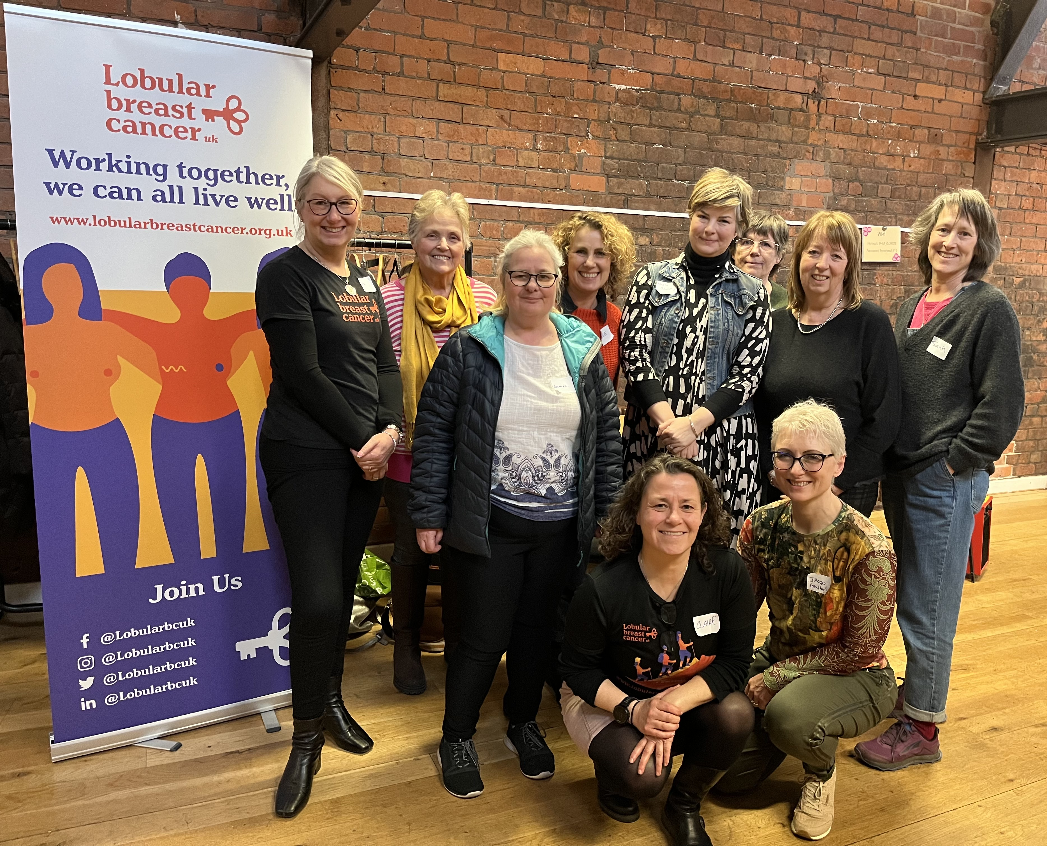
Claire Turner, Patient Advocate
6 year Stage II pleomorphic lobular breast cancer survivor
Founding Member and Chair of Lobular Breast Cancer UK (LBCUK)
Founding member European Lobular Breast Cancer Advocates (ELBCA)
UK Patient Advocate Representative European Lobular Breast Cancer Consortium (ELBCC)

